Slide 1
Patients Forum Meeting –
RACE EQUALITY IN THE LAS
Patricia Grealish, Director of People and Organisational Development

Slide 2
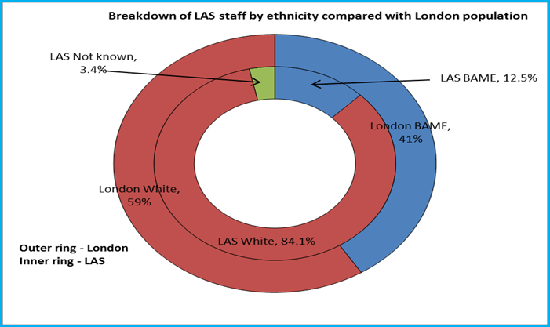
WORKFORCE RACE EQUALITY SCHEME (WRES)
COMPLIANCE
7% Paramedics BME staff
On-going activities
BME Staff Open Meetings – a programme of open meetings are in progress with the Chair, CEO and WRES Lead for BME staff to share their experiences of working for LAS
We have secured £500,000 from Health Education England to fund:
  Outreach into schools to raise profile of LAS as an employer and paramedic science as a potential career with BME students (and others)
  Coaching & mentoring for our BME talent
  Supporting and building the BME Staff Network to give staff a forum for raising issues and the Trust a BME ‘focus group’.
Positive action advertising to encourage applicants for posts from BME (and other under-represented communities).
We are planning to run the TRAC report once every quarter and review it, actions agreed.
Recruitment events set up between September and December
6th October Kenton 2-4pm
13th October Edmonton 2-4pm
27th October Ilford or Barking 2-4pm
10th November Diversity Careers fair Emirates stadium
24th November Skills London Excel centre

Slide 3
WRES INDICATORS - BOARD PROFILE AND DISCIPLINARY DATA
COMPLIANCE
Progress to date:
Data quality has improved significantly during the last 12 month period. All formal cases are entered into ESR and this information is shared and validated with HR teams on a regular basis.
The LAS WRES lead and National WRES Lead have held sessions with HR and ADO colleagues to ensure that managers are considering fairness and equity of approach and that consideration is given to resolving issues on an informal basis.
Notes:
-12 months ago we were not able to report on the recruitment indicator at all

Slide 4
WRES INDICATORS - TRUST PROFILE
COMPLIANCE
WRES indicator: Percentage of BME staff in Bands 1-9, VSM (including executive Board members and senior medical staff) compared with the percentage of BME staff in the overall workforce.

Slide 5
WRES INDICATORS - RECRUITMENT
COMPLIANCE

Slide 6
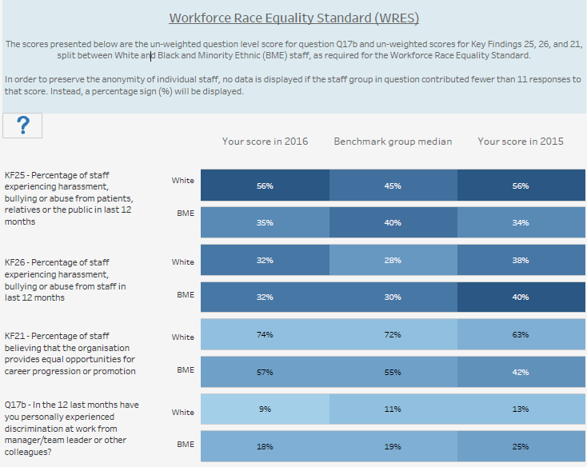
WRES INDICATORS - STAFF SURVEY
COMPLIANCE
The LAS has improved in three out of the four indicators.
Compared with all Ambulance Trusts, the LAS has performed above the benchmark group median in three of the four indicators.

Slide 7

Data
Notes:
We can now report on 8 of the 9 metrics
We are looking at the

Slide 8

BME Network
Notes:
Cannot be approach from one angle must be fulling integrated

Slide 9

Leadership
Notes:
Two Fold-
Commitment from Heather and the board
BME Lead

Slide 10
People & OD Strategy
Embedding a culture of inclusion will require us to develop accurate and timely intelligence about the experience of people from across the diversity spectrum. We will review the practices of other organisation and develop and implement clear reporting that will support our work
As we articulate the ‘behaviours’ that will inform the LAS culture we will ensure commitment is given to behaviours which support a collaborative and inclusive way of working. We will hold our leaders and managers accountable for these behaviours
We will continue to hold ourselves to account for the Workforce Race Equality and Disability Standards through developing action plans with inclusive engagement with our people and will demonstrate progress against all key indicators
We will establish clear Equality Objectives across all 9 protected characteristics which will form part of our continuing work on inclusion
Groups. We will encourage special interest groups to form and feedback through ‘tell the chief executive’ and other open meetings and forum

Slide 11
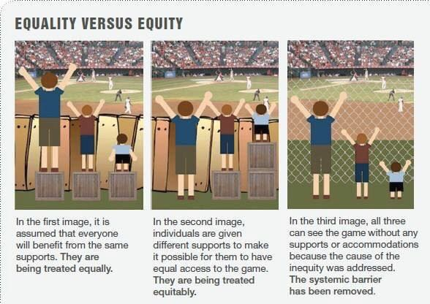
“There is nothing more unfair than the equal treatment of unequal people.”
- Thomas Jefferson 1743 - 1826

Slide 12
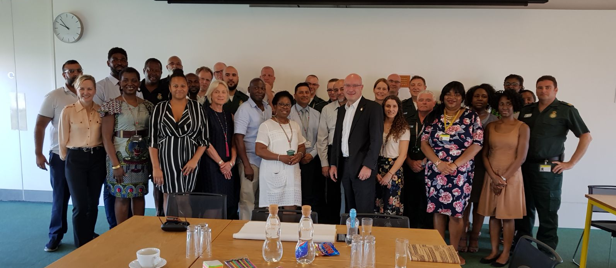
Solution's event
June 2017

